Slide 1

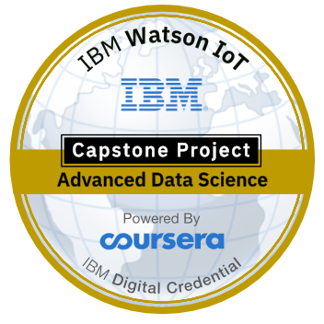
Restaurant recommender system
IBM Capstone project.

Slide 2
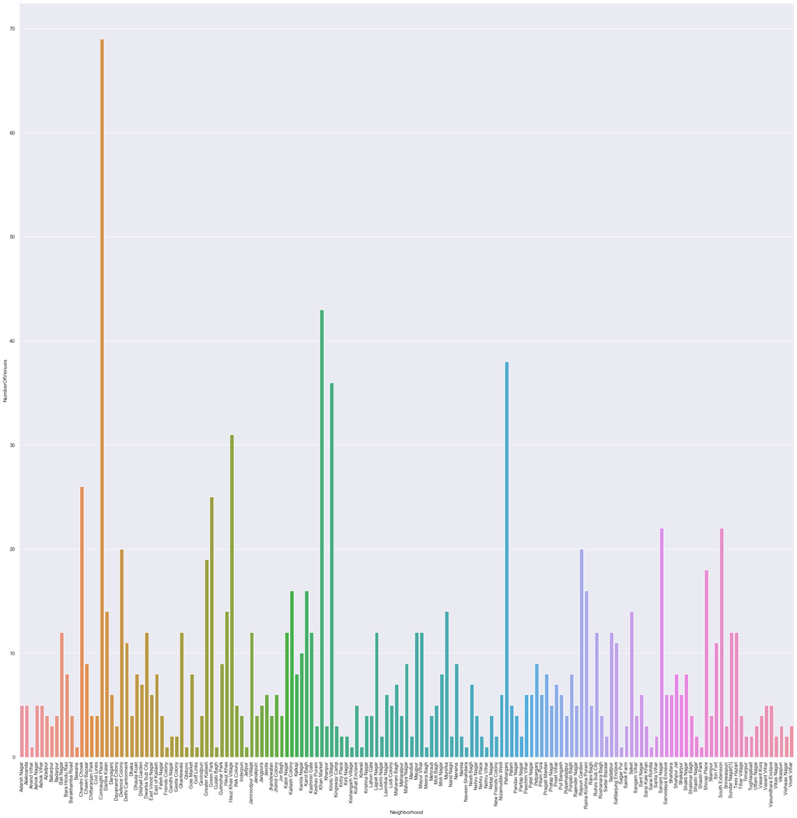
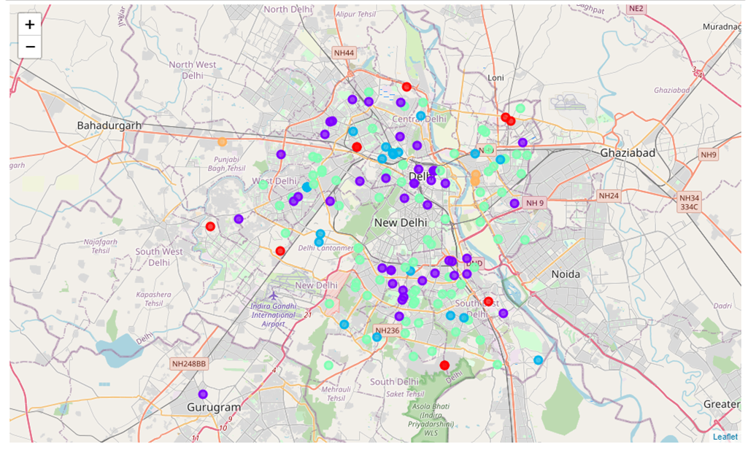
Methodology
Recommender System
Machine learning
Exploratory analysis
Inferential analysis

Slide 4
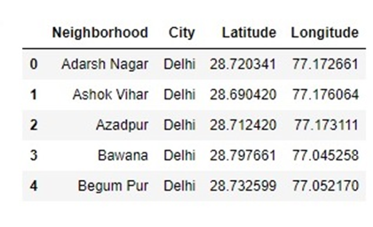
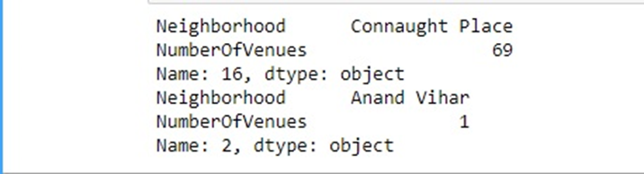
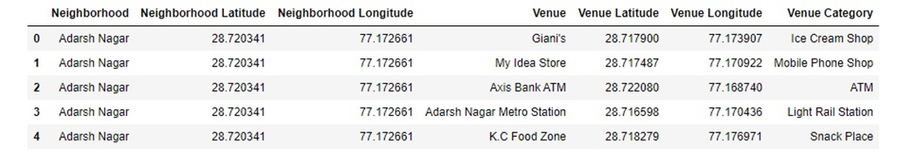
Datasets

Slide 5
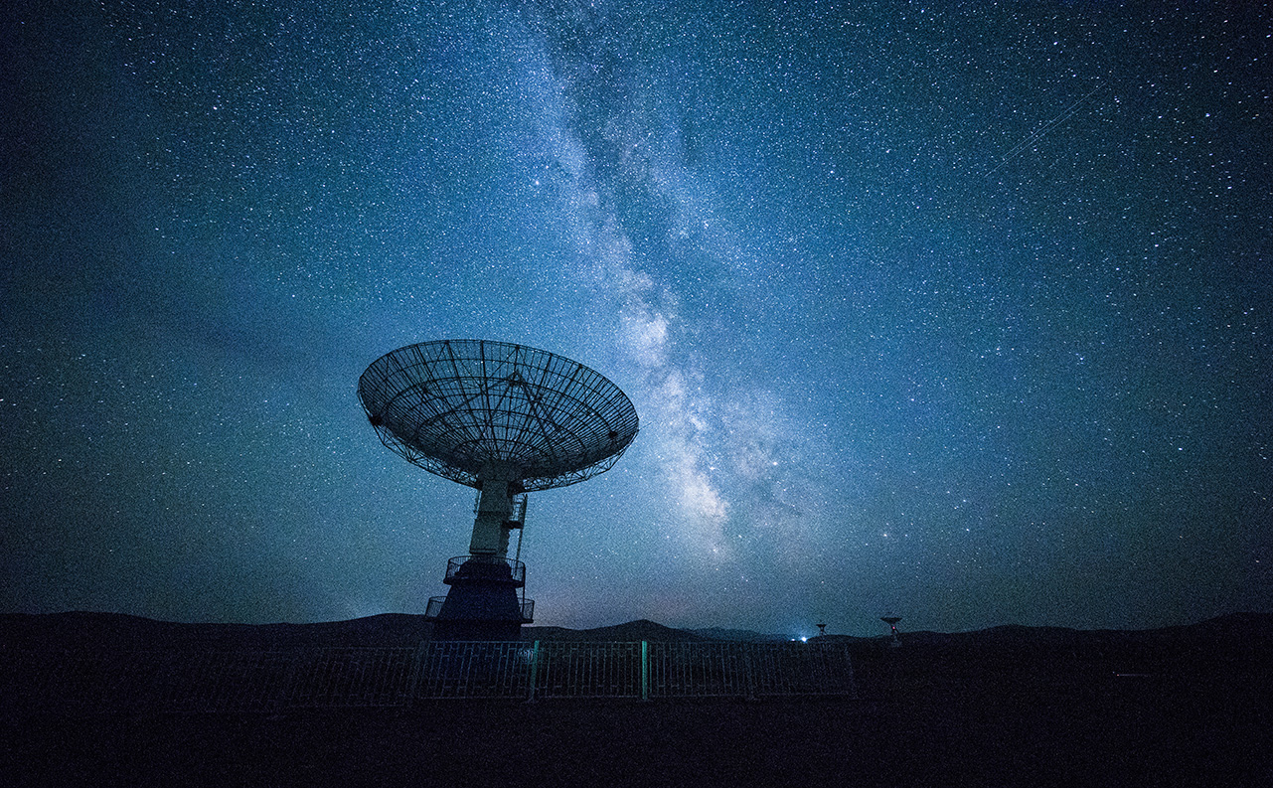
Mapping and clustering

Slide 6
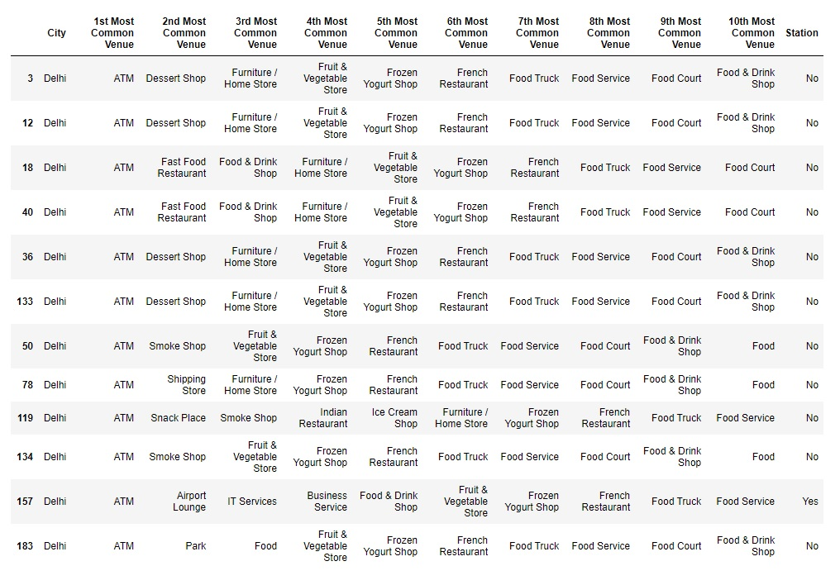
Results and conclusion

Slide 7

Thank You!
Vaibhav Thakur

